Slide 1
Unit 1 concepts of Nanomaterials
ENGINEERING CHEMISTRY BAS 102T/BAS202T
Dr. Nitya Sharma
Asstt. Prof.
Ajay Kumar Garg Engineering college, Ghaziabad

Slide 2
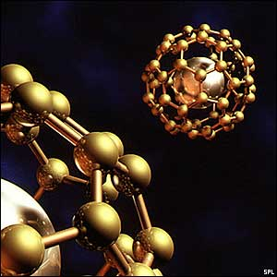
An Introduction to Nanotechnology
Nanomaterials are the materials possessing grain sizes on the order of a billionth of a meter
*(research literally exploded in
mid -1980s)

Slide 3
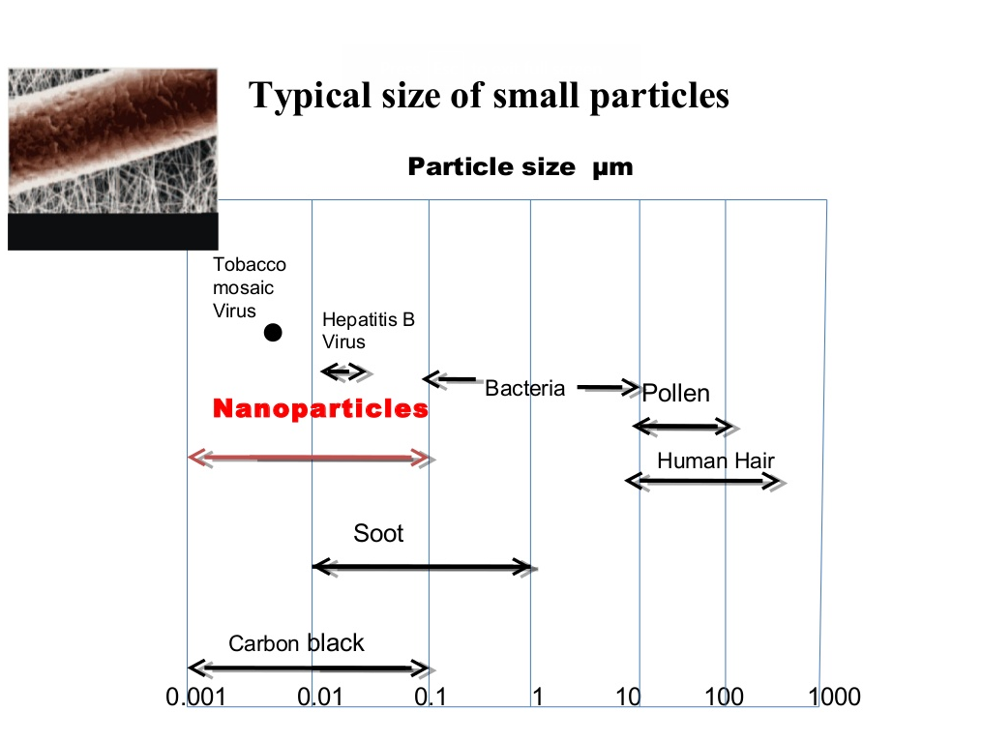
The average width of a human hair is in the order of 100,000 nanometers
A single particle of smoke is in the order of 1,000 nanometers

Slide 4
Nano Chemistry is the study of materials of the size 1 to 100 nm range.
Nanotechnology is the understanding and control of matter at dimensions of roughly 1 to 100 nm, where unique phenomena enable novel applications.
1 nm = 10⁻⁹ = I billionth of a meter | Limit of eye’s ability to see = 10,000 nm
Diameter of Hair = 750,000 nm | DNA width = 2 nm
H-atom = 0.1 nm | Bucky ball = 1 nm
Carbon nanotube = 1.3 nm | E. Coli bacteria = 2,000 nm

Slide 5
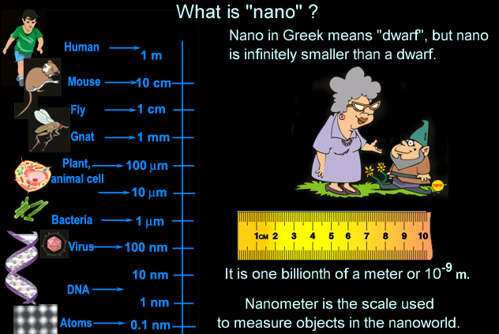
Definition Of Nanotechnology

Slide 6
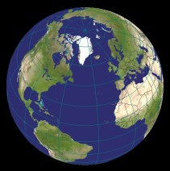

What is Nanoscale
Fullerenes C60
12,756 Km
22 cm
0.7 nm
10 millions times smaller
1 billion times smaller

Slide 7
What Is Nanotechnology
“Nanotechnology is the art and science of manipulating matter at the nanoscale”
Or
The application of science and scientific knowledge, at the nanoscale for industrial and commercial objectives.

Slide 8
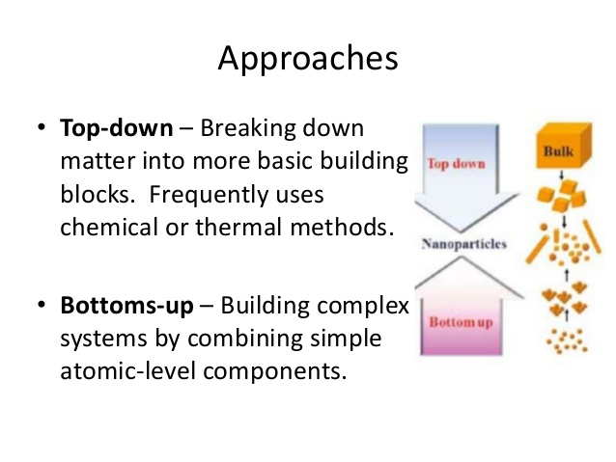

Slide 9
Wet Chemical Synthesis of Nanomaterials
1. The top down method : Where single crystals are etched in an aqueous solution for producing nanomaterials, For example, the synthesis of porous silicon by electrochemical etching.
2. The bottom up method: Consisting of sol-gel method, precipitation etc. where materials containing the desired precursors are mixed in a controlled fashion to form a colloidal solution.

Slide 10
 | Top down approach | Bottom Approach
1. | Pattern generated on a larger scale ,then reduced to nanoscale. | Start with atoms or molecules and build up to nanostructures.
2. | This approach is expensive | This approach is less expensive
3. | This approach is slow and not suitable for large scale production | This approach is suitable for large scale production
4. | Etching , lithography, erosion ,mechanical grinding | Molecular self assembly , gas phase , Agglomeration ,chemical vapour deposition.

Slide 11
Two principal factors cause the properties of nanomaterials to differ significantly from Bulk materials:
• Increased relative surface area
• Quantum effects. These factors can change or enhance properties such as reactivity, strength and electrical characteristics.

Slide 12
These factors can change or enhance properties such as reactivity, strength and electrical characteristics
Size, shape, specific surface area, aspect ratio.
Aggregation state.
Size distribution.
Surface morphology/topography.
Structure, including crystallinity and defect structure.
Solubility.
Size effects : Only by varying the particle size of the material , properties like m.pt , solubility, colour , transparency and catalytic behaviour changes.
Compositions effects : Different physical and chemical behaviour of the material is observed by varying the particle compositions

Slide 13
Surface Effects
As a particle decreases in size, a greater proportion of atoms are found at the surface compared to those inside. For example, a particle of
Size-30 nm-> 5% of its atoms on its surface
Size-10 nm->20% of its atoms on its surface
Size-3 nm-> 50% of its atoms on its surface
Nanoparticles are more reactive than large particles (Catalyst)properties like dispersibility,conductivity,catalytic behaviour and optical properties alter with it.
Composition effects : Different physical and chemical behaviour of the material is observed by varying the particle compositions.

Slide 14
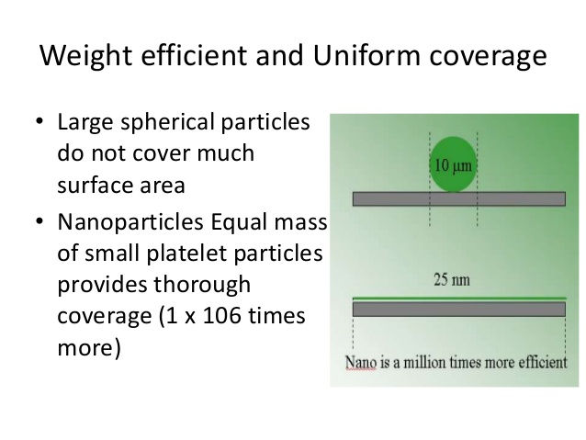

Slide 15
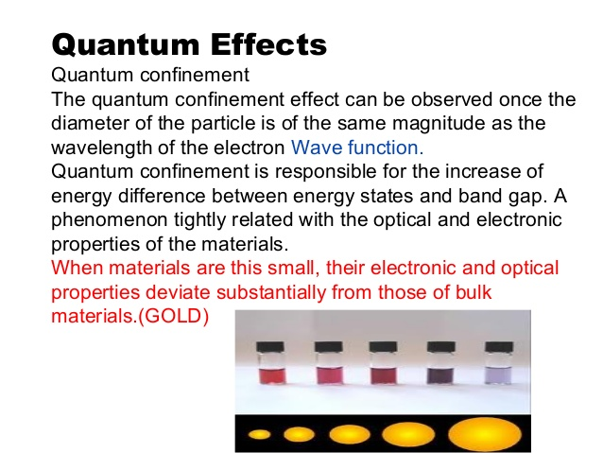

Slide 16
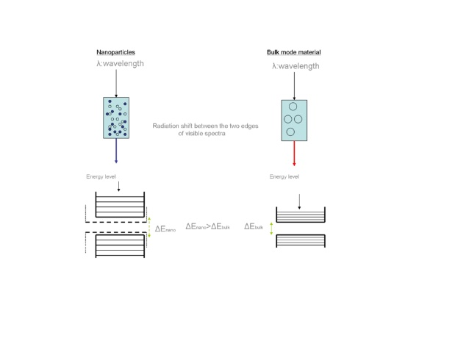

Slide 17
Classification of Nanomaterials
• Nanomaterials as those which have structured components with atleast one dimension less than 100nm.
• One dimension in nanoscale
Thin films
Surface Coatings
Computer chips
• Two dimensions in nanoscale
Nanowires
Nanotubes
• Three dimensions in nanoscale
Nanoparticles
Precipitates
Colloids
Quantum dots (tiny particles of semiconductor material)

Slide 18
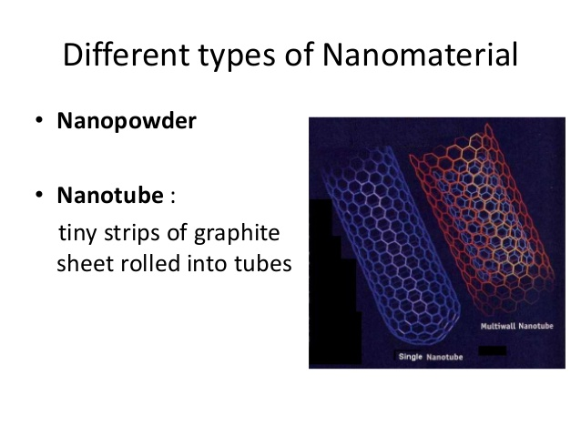

Slide 19
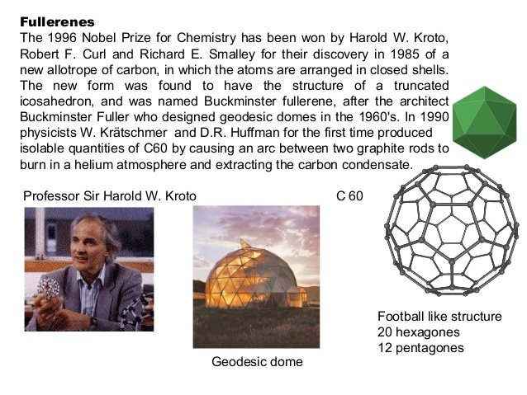

Slide 20
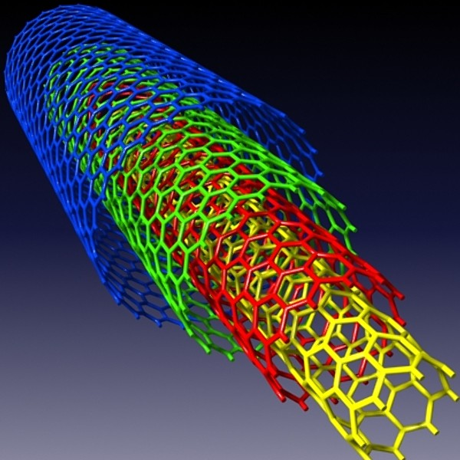
Carbon Nanotubes
Richard Smalley (1990) was the first to give the concept that if Bucky balls get big enough, they can become carbon cylinders.
Sumio Lijima discovered these carbon cylinders in 1991 and named them Nanotubes

Slide 21
Carbon nanotubes (CNTs)
Carbon nanotubes are tubular forms of carbon that can be envisaged as graphene sheets rolled into cylindrical form. 2.These nanotubes have diameters of few nanometers and their lengths are up to several micrometers. 3.Each nanotube is made up of a hexagonal network of covalently bonded carbon atoms. 4.Carbon nanotubes are of two types: single-walled and multi-walled.
5.A single-walled carbon nanotube (SWNT) consists of a single graphene cylinder whereas a multi-walled carbon nanotube (MWNT) comprises of several concentric graphene cylinders.

Slide 22
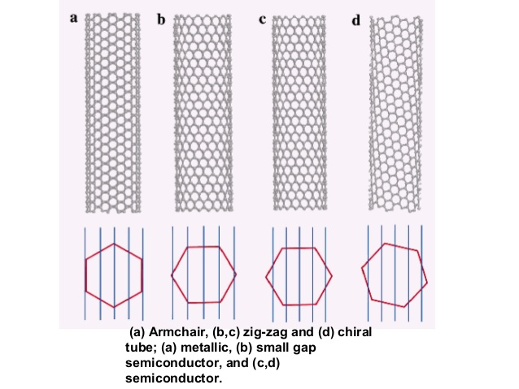

Slide 23
There are many useful and unique properties of CNTs.
Very High Tensile Strength -Carbon nanotubes are super-strong. The tensile strength of carbon nanotubes is approximately 100 times greater than that of steel of the same diameter.
High Electrical Conductivity
Highly Flexible- can be bent considerably without damage
Very Elastic ~18% elongation to failure
They are found thermally stable in vacuum up to 2800⁰C
Highly Absorbent
Carbon nanotubes are chemically neutral. So, they are chemically stable. Therefore, carbon nanotubes resist corrosion.

Slide 24
Applications of Carbon Nanotubes
Breast cancer tumor destruction:
nanotubes are used to destroy breast cancer tumors. They play with an antibody. The antibody along with nanotubes is attracted to the proteins by cancer cells in the body and nanotubes absorb the laser beam killing the bacteria of the tumor.
Windmill blades:
CNT’S are also used in the windmill blades because of their low weight . It increases the efficiency of the windmill and helps to produce more electricity at a faster rate.
Filtration:
carbon nanotubes can be used to separate particles of size greater than the diameter of carbon nanotubes during filtration through them. They can also be used to trap smaller sized ions from a solution.
Carbon nanotubes as Nano cylinders:
gas like H2, for energy, battery for vehicles can be safely stored inside the carbon nanotubes and the problem of H2 storage hazards can be solved.
Carbon nanotubes have also been shown to absorb infrared light and may have applications in the IR optics industry.
Aircraft stress reduction:
nanotubes are also used in space and aircraft to reduce the weight and stress of the various components working together.
Other uses of carbon nanotubes – they are used as catalysts in some reactions. They are also used in drug delivery systems and in applications related to conductivity in electronics.

Slide 25
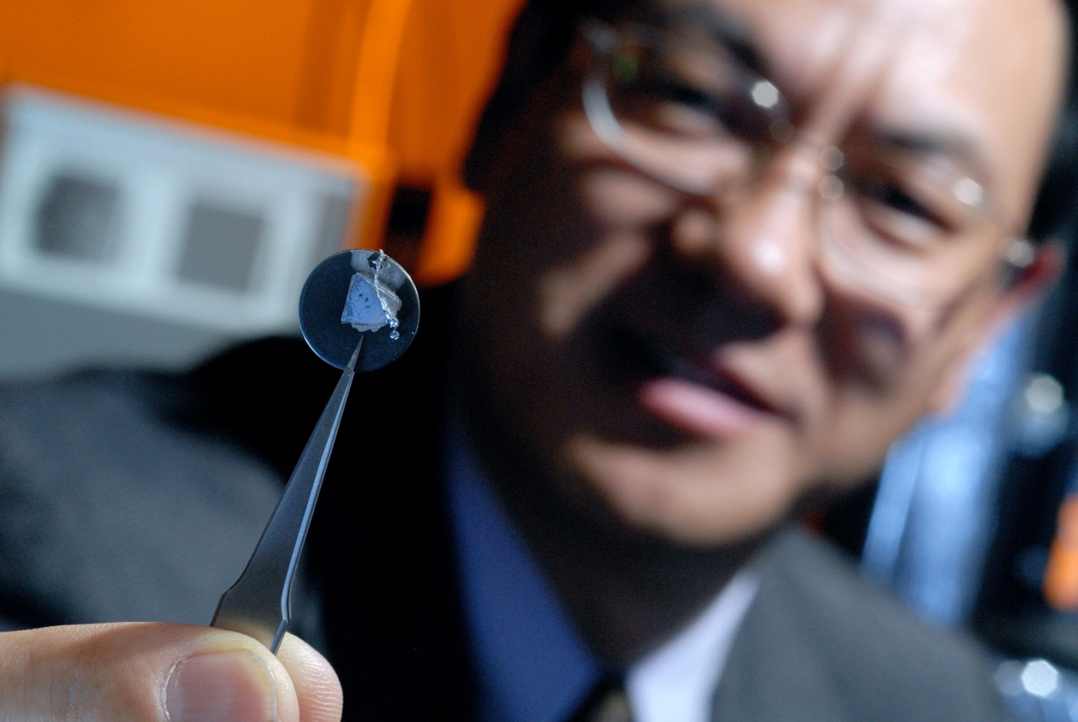
Applications of Nanotechnology
Notes:
lets have a look how NT is leading us in different areas of expertise..

Slide 26
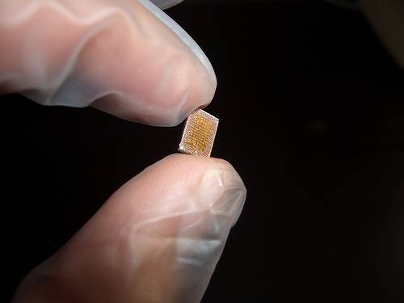

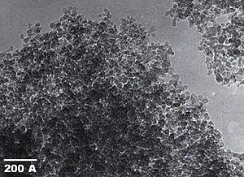
Applications Of Nanotechnology
Nano Transistors
Nano Tubes
Artificial Retina
Nano Particles
Notes:
e.g: in da field of electronics nanotransistors are becoming more nd more popular bcoz of it’s compactness..
If u are thinking that this is a single transistor then you need to reshape your thinking, bcoz this is a transistor box containing thousonds of transistors in it…
Some other examples of nanoelectronics are Nanodiodes, OLEDs etc.

Slide 27

Advantages of Nanotechnology

Slide 28
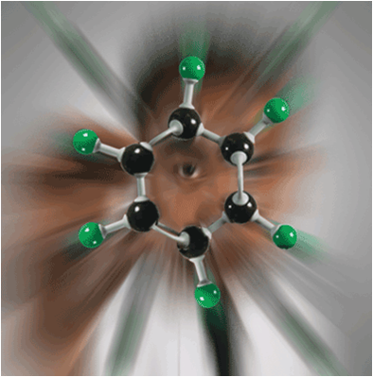
Advantages
Nanotechnology is used in many computing, communications, and other electronics applications to provide faster, smaller and more portable systems that can manage and store larger and larger amounts of information
Notes:
1- computers can become a billion times faster and a million times smaller..
2- Automatic cleanup of Pollution..
3- Manufacturing at almost No cost..

Slide 29
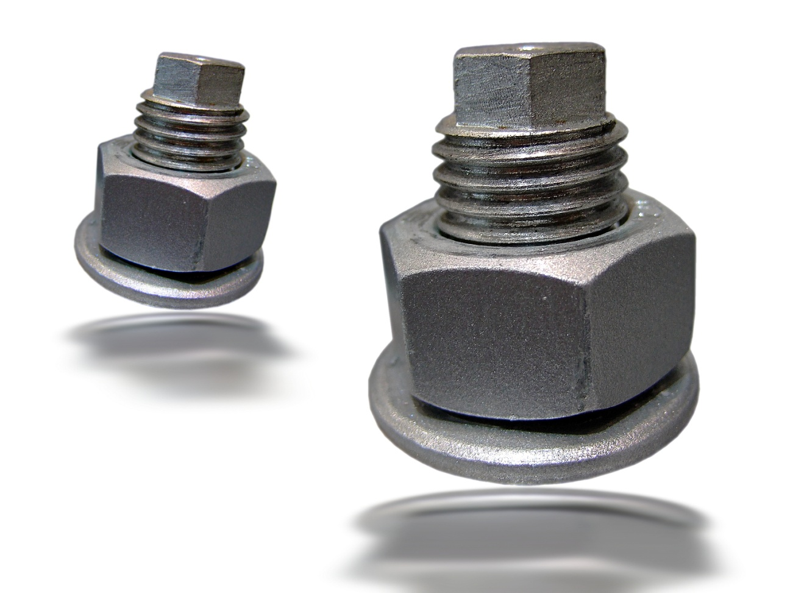
Advantages
Material
With NT, we can create unique materials and products which are:
Stronger
Lighter
Cheaper
Durable
Notes:
With NT, we can create unique materials and products which are: Stronger, Lighter, Cheaper, Durable and even Precise all at the same time

Slide 30
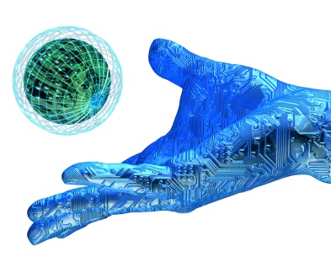
Future Of Nanotechnology
National Science and Technology Council (USA) claims that:
“Nanotechnology is an enabling technology that will change the nature of almost every human-made object in the next century”

Slide 31
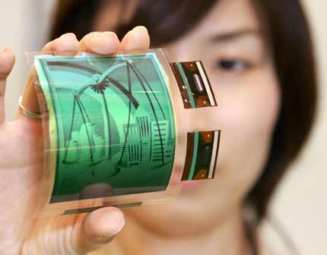
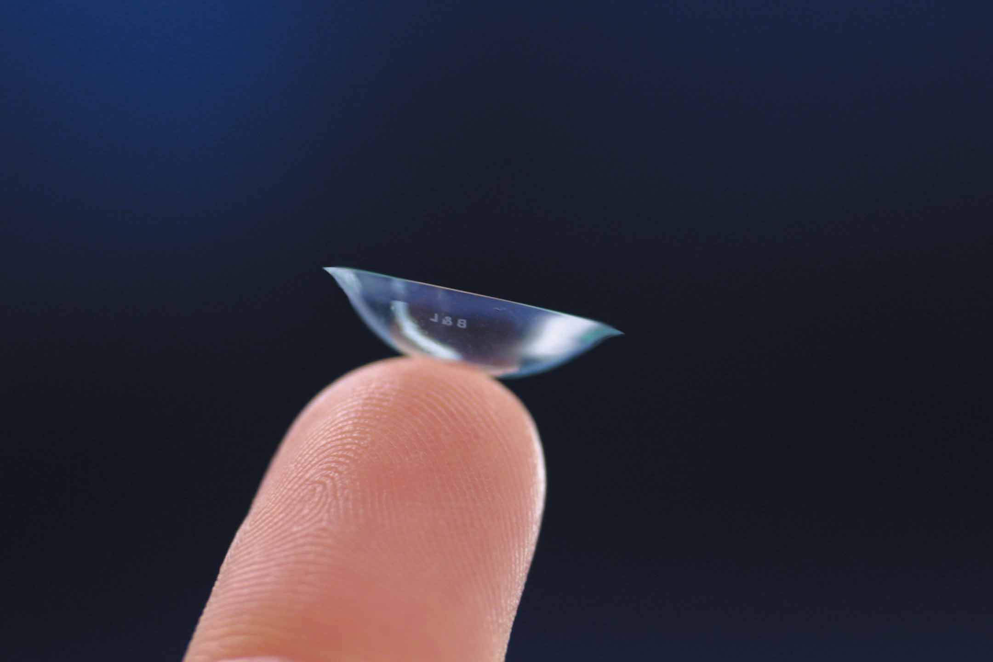
Examples of Future Use of NT
Future Of Nanotechnology
Electronic Paper
Contact Lens
Notes:
1- In future, you might be reading news on foldable electronic paper..
2- This is the proto type of Nokia Morph concept phone based purely on NT..
3- Contact lens that will let you check your blood sugar level by looking into a mirror. (It is expected to be coming in 5 years or so.

Slide 32
3. Sunscreens and Cosmetics
Nanosized titanium dioxide and zinc oxide are currently used in some sunscreens, as they absorb and reflect ultraviolet (UV) rays.
4. Fuel Cells
The potential use of nano-engineered membranes to intensify catalytic processes could enable higher-efficiency, small-scale fuel cells.
5. Displays
Nanocrystalline zinc selenide, zinc sulphide, cadmium sulphide and lead telluride are candidates for the next generation of light-emitting phosphors.
CNTs are being investigated for low voltage field-emission displays; their strength, sharpness, conductivity and inertness make them potentially very efficient and long-lasting emitters.

Slide 33
8. Magnetic Nano Materials applications
It has been shown that magnets made of nanocrystalline yttrium–samarium–cobalt grains possess unusual magnetic properties due to their extremely large grain interface area (high coercivity can be obtained because magnetization flips cannot easily propagate past the grain boundaries).
This could lead to applications in motors, analytical instruments like magnetic resonance imaging (MRI), used widely in hospitals, and microsensors.
Nanoscale-fabricated magnetic materials also have applications in data storage.
Devices such as computer hard disks storage capacity is increased with Magnetic Nano materials

Slide 34
9. Medical Implantation
.
Unfortunately, in some cases, the biomedical metal alloys may wear out within the lifetime of the patient. But Nano materials increases the life time of the implant materials.
Nanocrystalline zirconium oxide (zirconia) is hard, wear resistant, bio-corrosion resistant and bio-compatible.
It therefore presents an attractive alternative material for implants.
Nanocrystalline silicon carbide is a candidate material for artificial heart valves primarily because of its low weight, high strength and inertness.

